Slide 1

Working With Data DATA9910
Week 8
Lucas Rizzo
email: lucas.rizzo@tudublin.ie

Slide 2
Indicative schedule
Week 1 | Set up environment and R notebook
Week 2 | Review Python and practice
Week 3 | Review R Importing data with R
Week 4 | Intro SQL and aggregate queries
Week 5 | Databases and scripting languages (To be submitted)
Week 6 | Interpreting Data (summary statistics, data visualisation)
Week 7 | Review week
Week 8 | Data manipulation in R Pandas and Numpy
Week 9 | Data visualisation in Python Data processing (regular expressions)
Week 10 | Audio data (R and tuneR) (To be submitted)
Week 11 | Image data (Python and skimage) (To be submitted)
Week 12 | Time series (Python and Pandas)
Week 13 | Working on Assignment Assignment deadline

Slide 3
Overview
Numpy arrays
Pandas dataframes
How to select rows and columns
How to query
How to calculate summary statistics on Pandas dataframes

Slide 4
NumPy
NumPy is short for Numeric Python
NumPy was designed to make Python suitable for Numerical Computing
NumPy provides vector-like arrays, similar to what we have in R

Slide 5
Lists vs Arrays
A Python list is a sequence of pointers in memory
Quite slow for large arithmetic operations
A NumPy array is a sequence of values stored together in a single block
Very fast for vector operations
NumPy Array ≈ R Vector

Slide 6
Lists vs Arrays - Example
We can create a NumPy array by passing a list to the np.array() function
Create two lists, l1 and l2, containing [1, 2, 3] and
[4, 5, 6]
Create two arrays, a1 and a2, using np.array()
Add the two lists using the + operator
Add the two arrays using the + operator
Multiply the arrays using the * operator

Slide 7
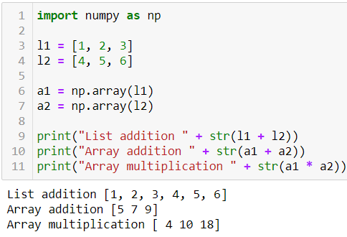
Lists vs Arrays - Example

Slide 8
Ranges in NumPy
np.arange(start, stop, step) creates a range of integers
np.linspace(start, stop, count) creates count numbers evenly spaced between start and stop
Example: generate a sequence of numbers from (10, 20, … 90, 100) using np.arange() and np.linspace()

Slide 9
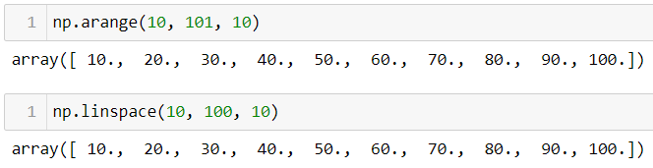
Ranges in NumPy
np.arange(start, stop, step) creates a range of integers
np.linspace(start, stop, count) creates count numbers evenly spaced between start and stop
Example: generate a sequence of numbers from (10, 20, … 90, 100) using np.arange() and np.linspace()

Slide 10
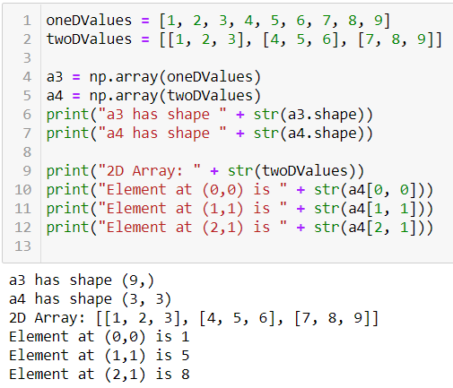
Array Shape
NumPy arrays are of a fixed size
Two dimensional arrays contain rows and columns
The shape property of a NumPy array tells us how many rows and/or columns it has

Slide 11
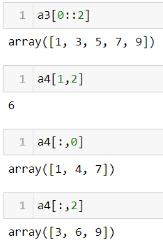
Slicing NumPy Arrays
NumPy arrays can be sliced just like regular lists
The colon operator allows us to choose a start, stop and step
The comma after the end let’s us get the same index from each returned array

Slide 12
Pandas
Pandas (short for Panel Data) is a package providing functionality similar to R's dataframe
Tables are represented as pd.DataFrames and rows are represented as pd.Series
The syntax for Pandas is similar to the R dataframe syntax

Slide 13
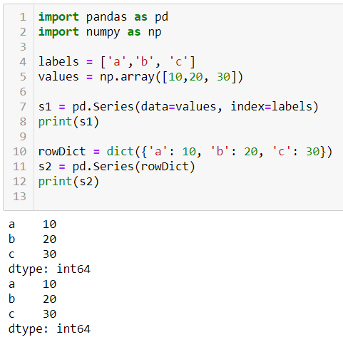
Pandas Series
A Series is an array of values with associated labels
Values can be accessed by label or by index
We can create a series by supplying NumPy arrays and labels as lists
Or we can use a Python dictionary

Slide 14
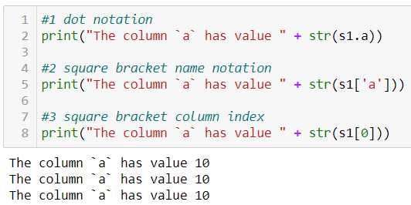
Pandas Series
We have three ways of accessing a value from a Pandas Series
1. Using the column name with dot notation
2. Using the column names with square bracket notation
3. Using the column index with square bracket notation

Slide 15
Pandas DataFrame
The easiest way to create a Pandas DataFrame is to use a list of python dictionaries.
The dictionary key is taken to represent the column name while the value represents the value for that row
By creating a list of dictionaries we can gather together our initial data for creating a dataframe.

Slide 16
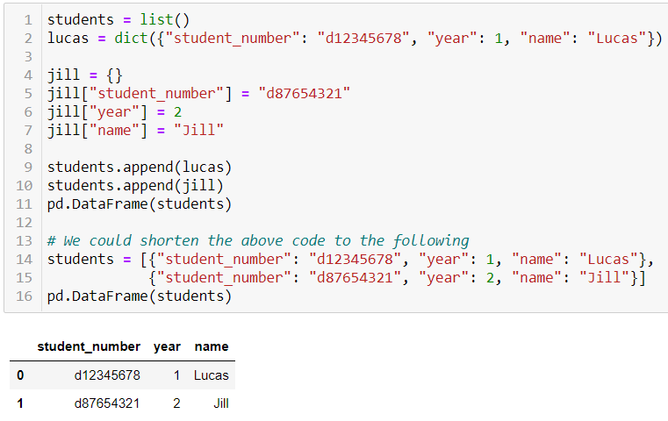
Pandas DataFrame

Slide 17
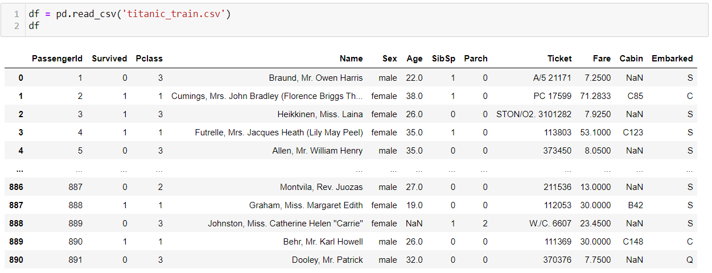
DataFrame from csv
We can also create a dataframe directly from a CSV file.
As with the read.csv and read_csv functions in R, there are lots of parameters we can tweak to suit our data file
You can find a full list by looking up the documentation

Slide 18
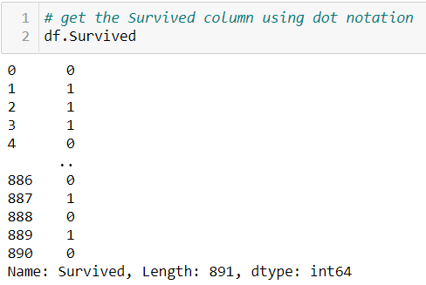
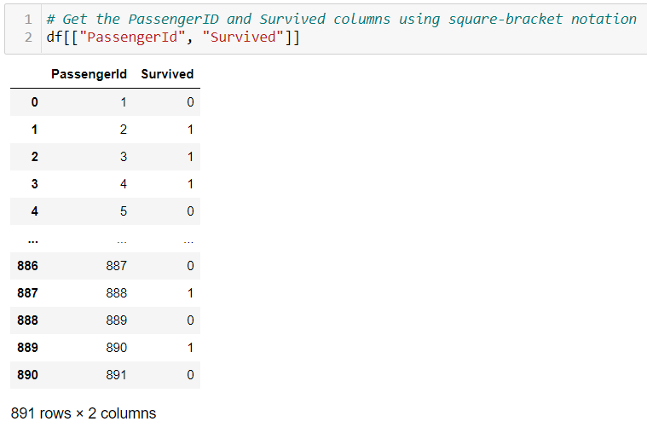
Indexing and Slicing Columns
Columns can be accessed using dot notation or square bracket notation.
If we want to access multiple columns we have to use square bracket notation

Slide 19
Indexing and Slicing Rows
We can select rows from a pandas dataframe using the .loc and .iloc properties.
loc allows us to select rows and columns by name, whereas iloc allows us to select rows and columns by index.
Usually rows have a numeric index (though it is possible to give rows a named index).
If the index is numeric (as is default) we can use row indexing with loc

Slide 20
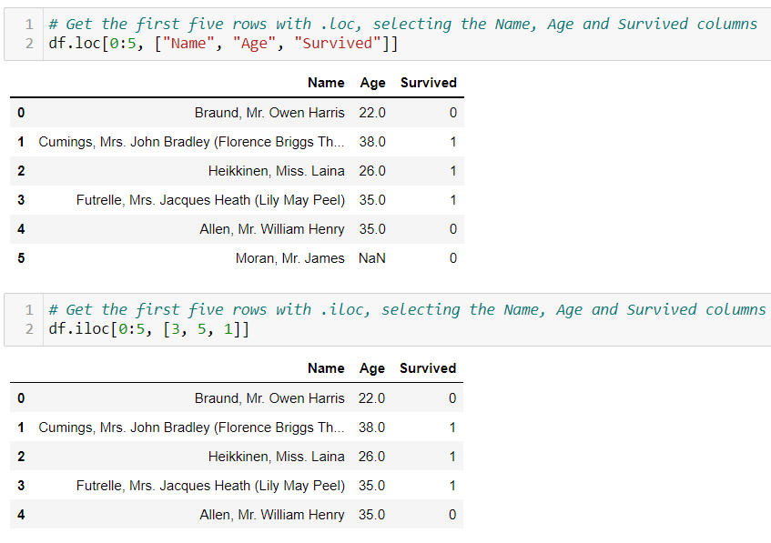
Indexing and Slicing Rows

Slide 21
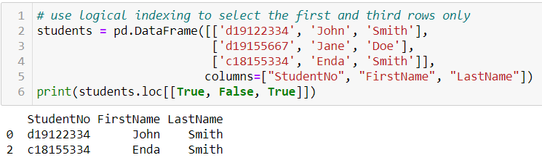
Logical Indexing
Just like with R, the .loc property can use logical indexing
If we pass a vector the same length as our column it will return only rows corresponding to True values in the indexer

Slide 22
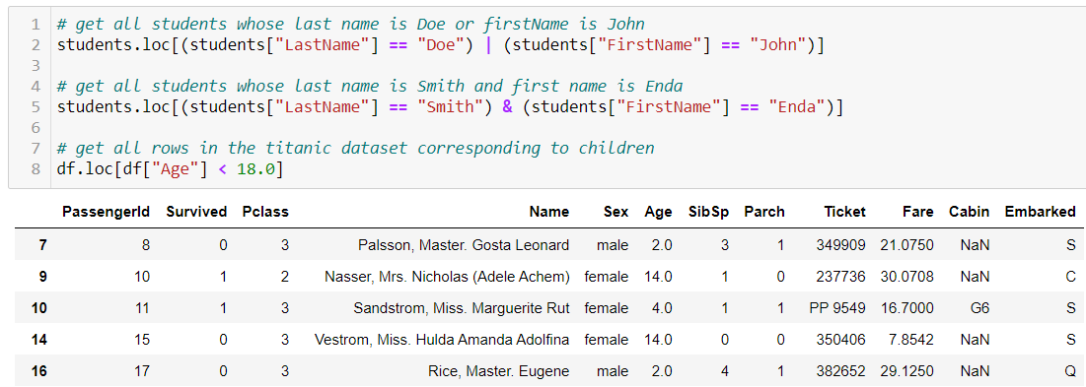
Boolean Operators
Just like in R, we can combine conditions using logical-or | and logical-and &

Slide 23
The Query Syntax
As you may have noticed, a basic pandas query can result in quite a few keystrokes, particularly when the criteria is anything other than a single simple operation.
Pandas provides a special function, query(), which allows you to use a shorter syntax for any of these expressions.
This allows me, for example, to write the students' name query much more succinctly

Slide 24
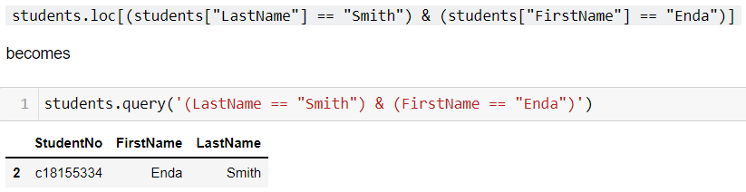
The Query Syntax

Slide 25
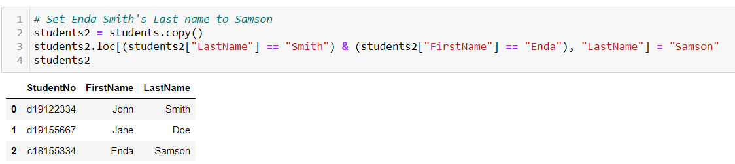
Setting Values using .loc
We can assign values using .loc, just like with R
Simply follow up our .loc statement with a = value

Slide 26
Calculating Summary Statistics
Calculating summary statistics is similar in Python to R
In R, we called the function and passed in the column
In Python we call the function on the column object
R
mean(df$age)
Python
df.Age.mean()
More examples in the notebook!

Slide 27
Summary
In this section we learned about:
Numpy arrays and how they're equivalent to R vectors
Pandas dataframes and how they're similar to R's dataframes
Pandas Series, which represent rows of a dataframe
How to select rows and columns with .loc and .iloc
How to query using the query() syntax
How to calculate summary statistics on Pandas dataframes
More practice on DataCamp: Data manipulation with Pandas
Python for Data Science

Slide 28
Questions?

Slide 29
Lab
Lab week 8 on Brightspace

